Slide 1
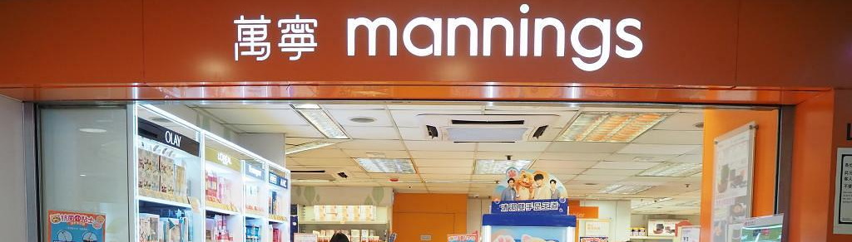
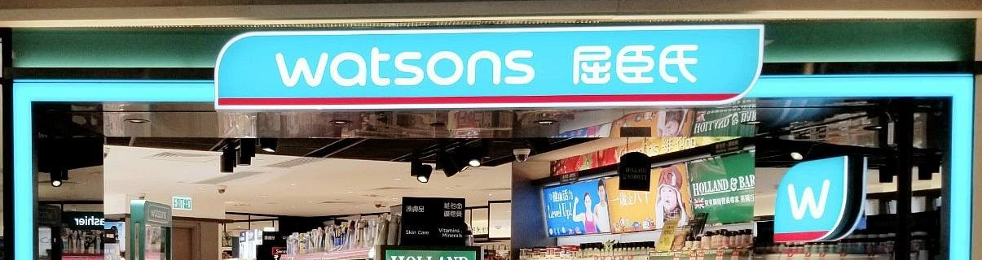
2022 EDA Project
Retail stores geographic strategy analysis
Team 4
Elvis Tse
Irene Lau
Darren Shum
Tracy Cheung

Slide 2

INTRODUCTION
Project Aims
Aims :
Retail stores geographic strategy analysis
This project objective is to figure out the strategic relationship between retail stores distribution and their geographical locations. We took a pair of direct business competitors, Mannings & Watsons for analysis and comparison. Similar research approach can also be applicable to other business rivals, for instance, Parknshop & Wellcome, 7-11 & OK.

Slide 3
CONTENTS
What we do
Show case
our work
clients
1
2
3
4
5
6
Starts
How to
Analysis
End
Meet our Team
Select Data
Charts & polls
question

Slide 4
MEET OUR TEAM
Introduce members
Elvis
Darren
Tracy
Irene
Elvis
Tracy
Darren
Irene Lau
Responsible for
Data of WATSONS
Responsible for
Data of MANNINGS
Responsible for
Data of 2021 Hong Kong Population Census
Responsible for
Data of 2021 Hong Kong Population Census

Slide 5
What we do our work
We need the materials
Data of MANNINGS
Compare the Data
Find the Relationship between Different Data
Data of WATSONS
Data of 2021 Hong Kong Population Census
Come to Conclusion

Slide 6


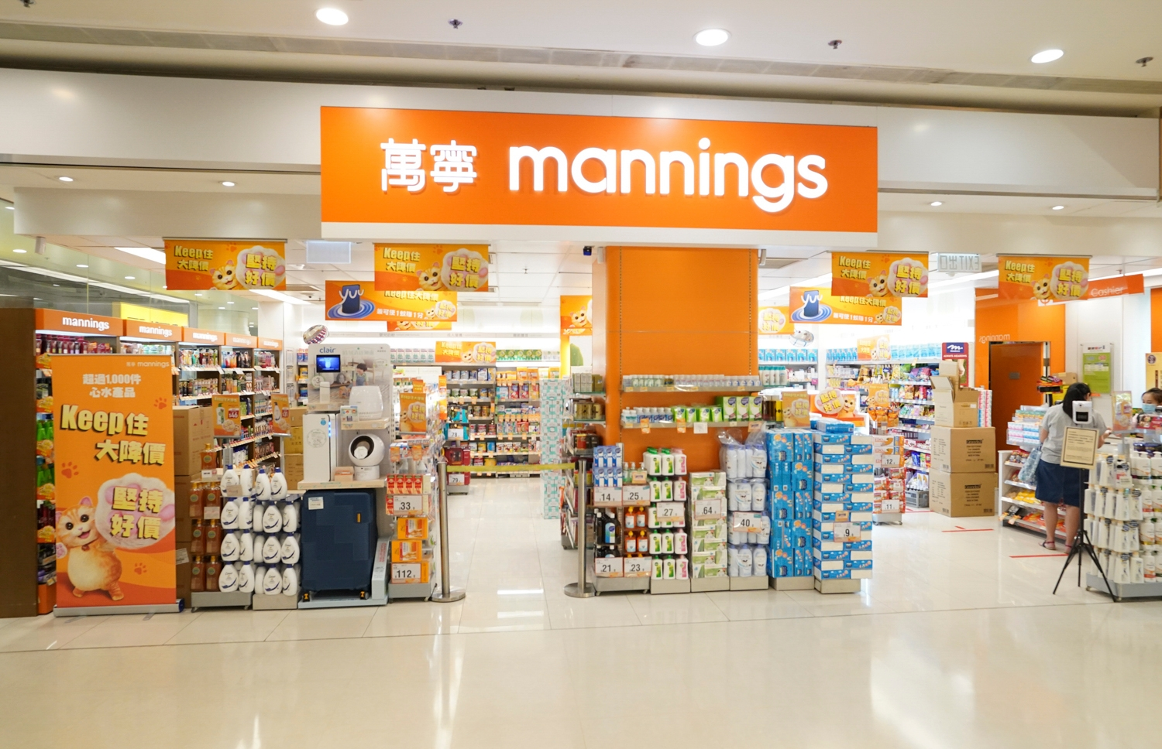
Company Background
Owner : Dairy Farm International Holdings
Year of Established : 1972
Kind : Health Care and Beauty
Total stores : 329 shop in Hong Kong
Products: Quality health care
Personal care,
Skin care
Baby products
Services: Free consultations
from registered Pharmacists,
Dieticians, beauty and
health advisors

Slide 7

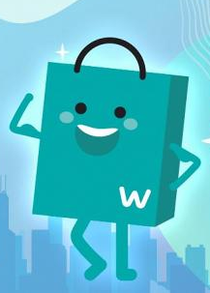
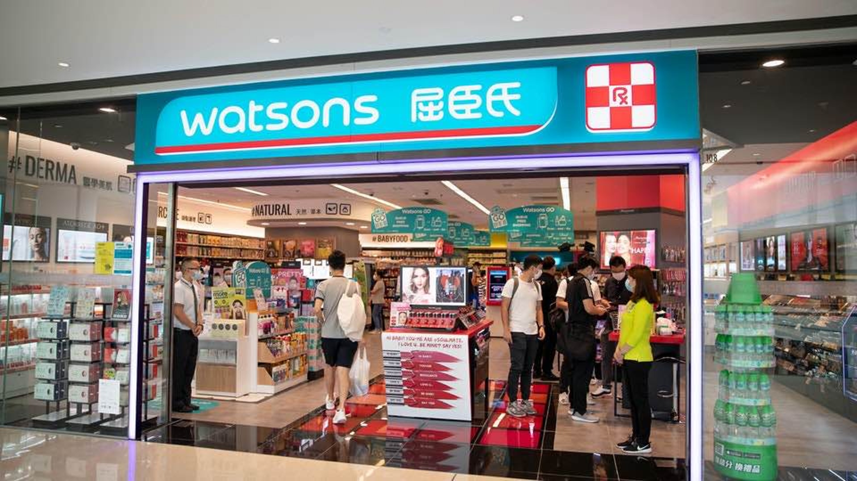
Company Background
Owner: CK Hutchison Holdings
Year of Established : 1828
Kind : Health Care and Beauty
Total stores : 154 shops in Hong Kong
Products: Quality health care
Personal care
Skin care
Baby products
Services: Online Doctor Consultation
Pharmacy
Nutrition & Dietary
Chinese Medicine Service

Slide 8
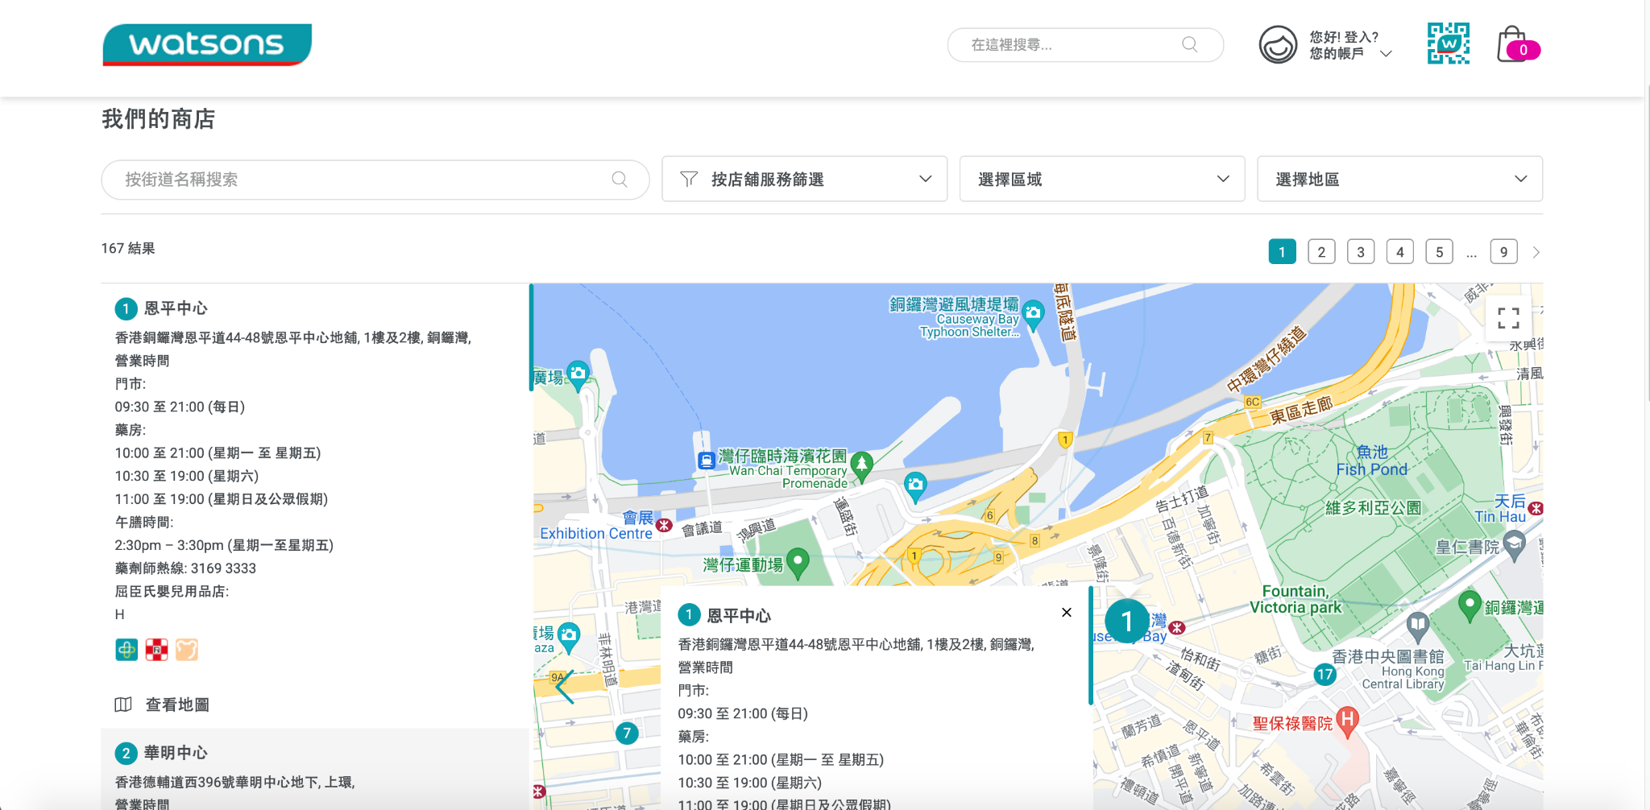
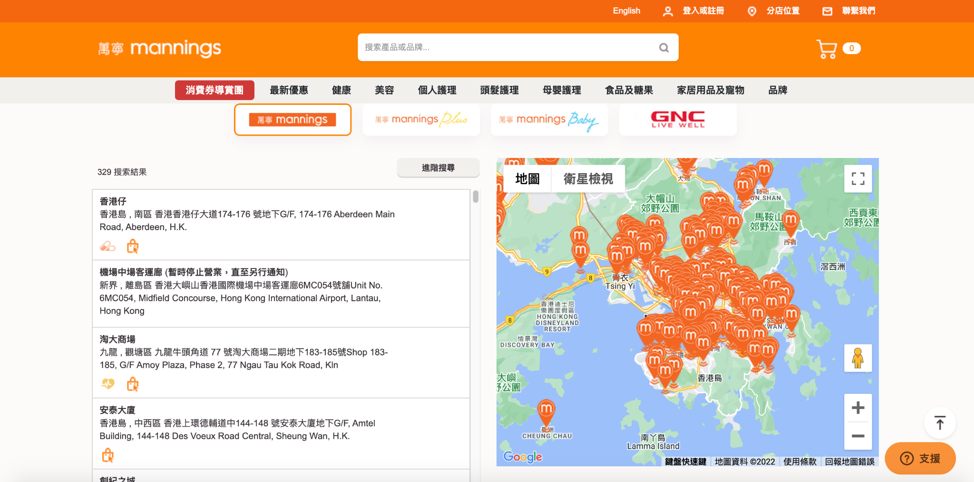
HOW TO SELECT DATA
We do the following things
SELECT Data of MANNINGS
Web Scraping
Data Source from :
https://www.mannings.com.hk/store-finder
Web Scraping
Data Source from :
https://www.watsons.com.hk/store-finder
SELECT Data of WATSONS

Slide 9
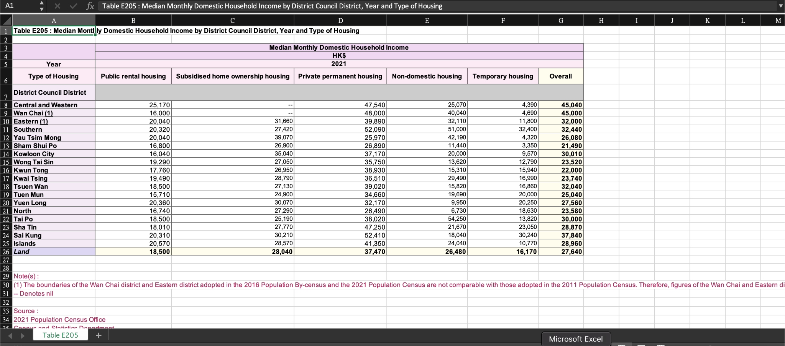
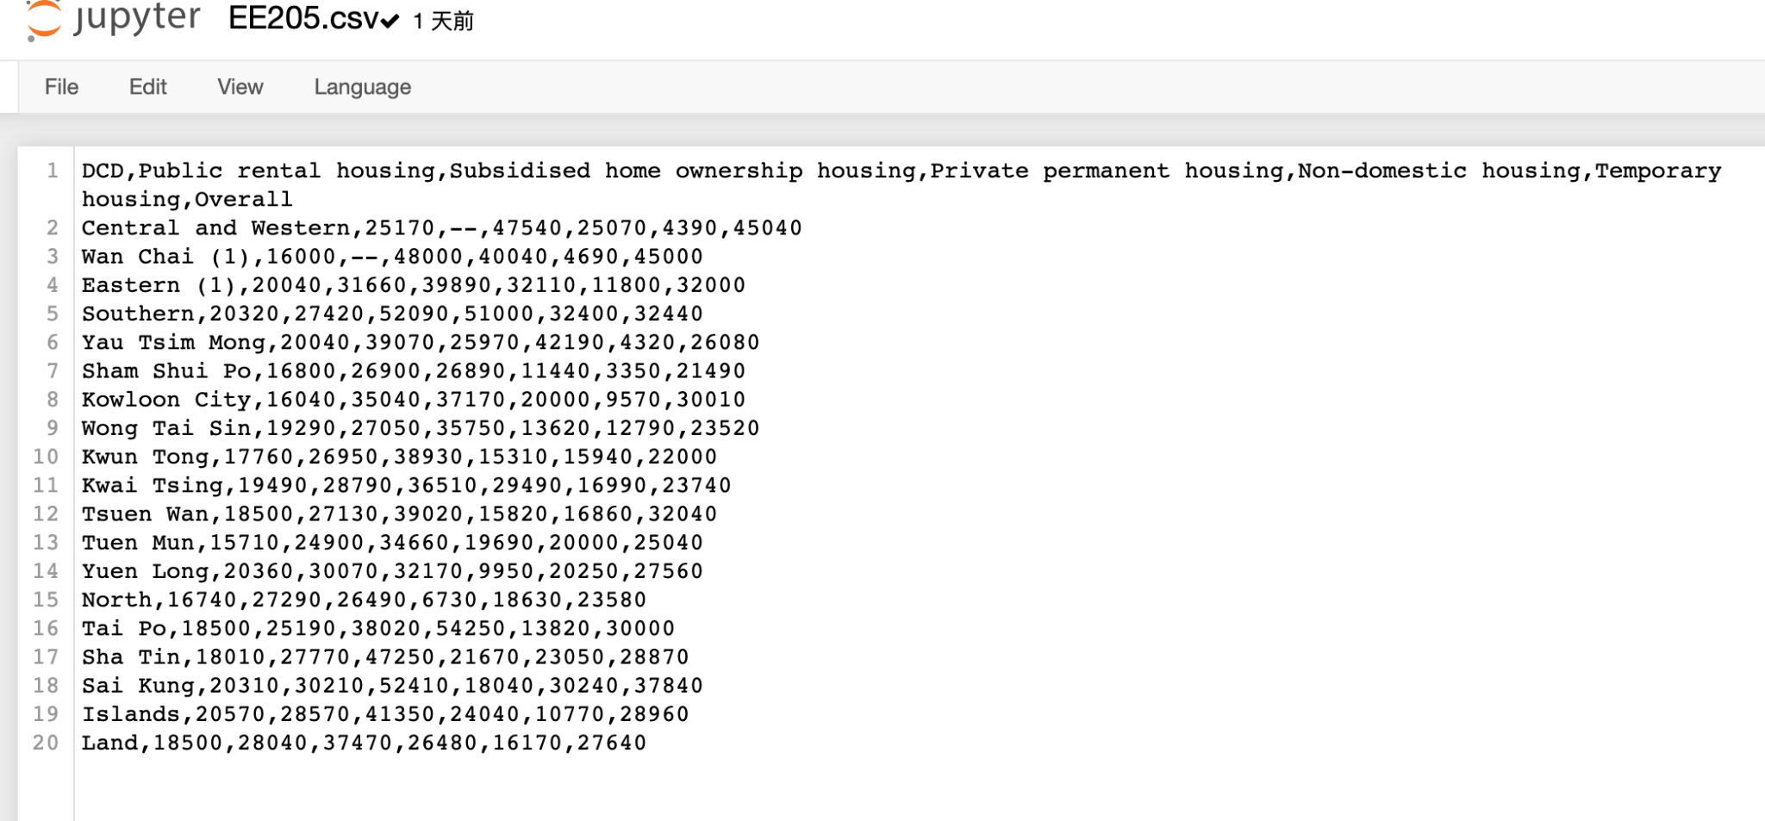
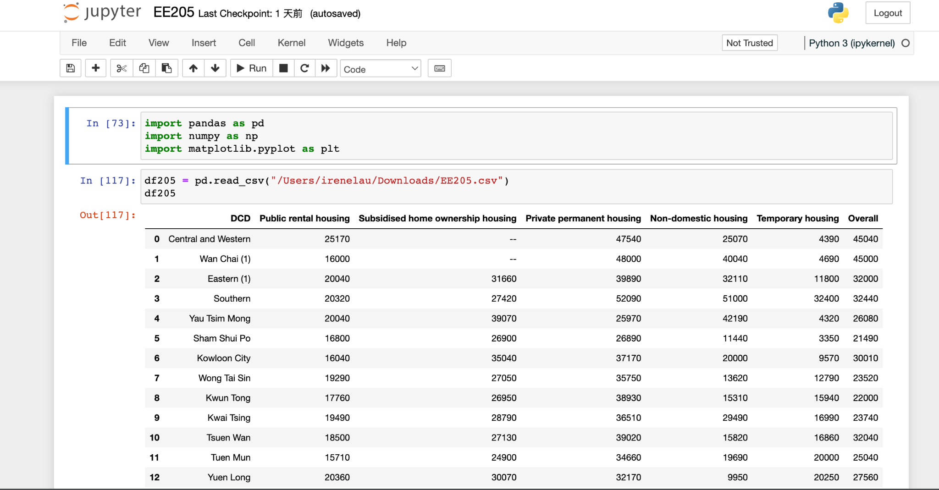
SELECT Data of 2021 Hong Kong Population Census
Data Source from :
https://www.census2021.gov.hk/en/main_tables.html
We use the following table :
A204 - Population by Sex, Age, Year and District Council District
D203b - Median Monthly Domestic Household Income by District Council District and Year
E205 - Median Monthly Domestic Household Income by District Council District, Year and Type of Housing
E210 - Occupied Quarters by District Council District, Year and Type of Quarters
Excel
CSV
JUPYTER

Slide 10
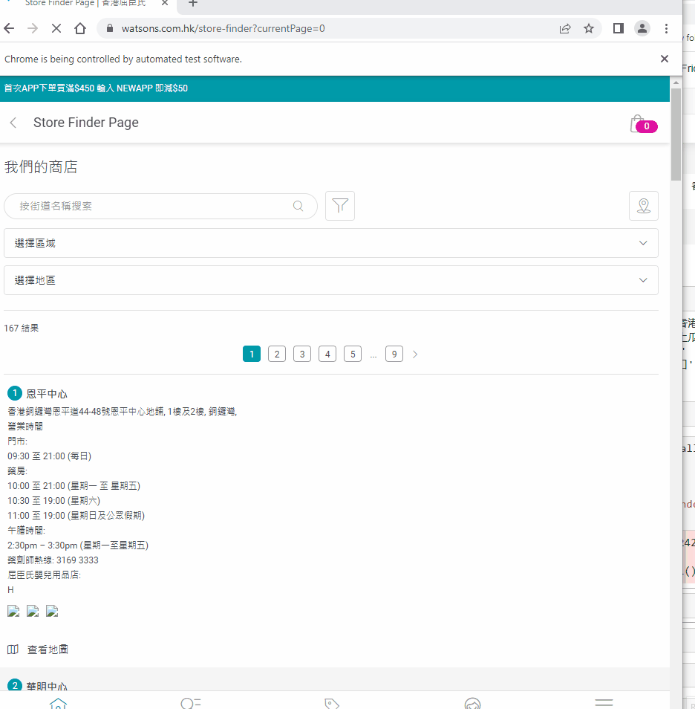
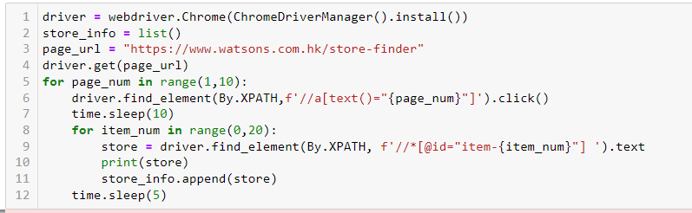
CHALLENGE AND HOW TO DEAL WITH
During web scraping
Issue | Solution taken | Elaboration
Encountered Javascript characteristic, unable to loop through page_num | Selenium instead of BeautifulSoup | More versatile and flexible, can perform action like click button

Slide 11
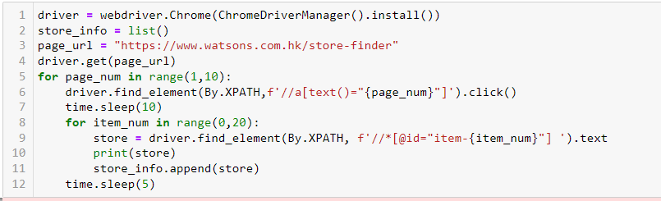
CHALLENGE AND HOW TO DEAL WITH
During web scraping
Issue | Solution taken | Elaboration
Web responsiveness | time.sleep() | Hardcode delay in execution in between loop to allow sufficient time for page to load and get the result (also knew that a better way to archive is to make use of ExpectedConditions in Selenium WebDriver)

Slide 12
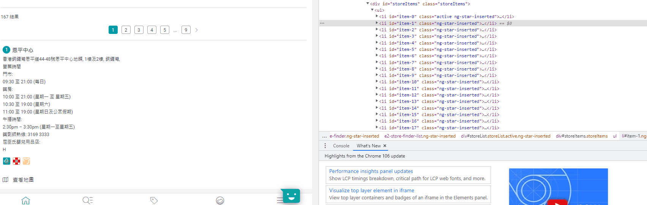
CHALLENGE AND HOW TO DEAL WITH
During web scraping
Issue | Solution taken | Elaboration
 | driver.find_element (By.XPATH, "xpath") | Locate by XPATH is more specific and more importantly, XPATH can be easily obtained.

Slide 13
DATA PROCESSING & ANALYSIS

Slide 14
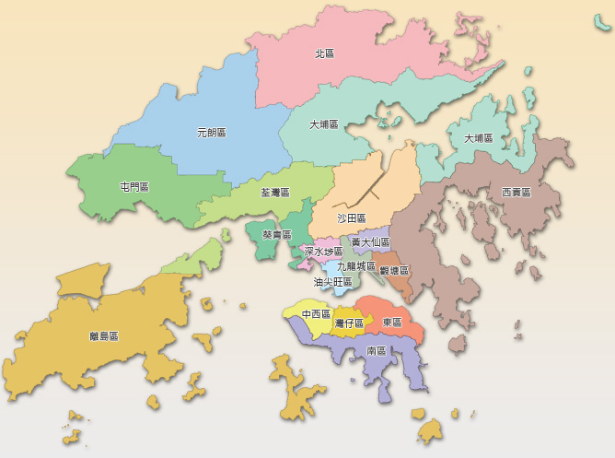
Map of Hong Kong District Councils
Hong Kong
The local councils for the 18 districts of Hong Kong.
Hong Kong
Central and Western
Eastern
Southern
Wan Chai
Kowloon
Kowloon City
Kwun Tong
Sham Shui Po
Yau Tsim Mong
Wong Tai Sin
New Territories
Islands
Kwai Tsing
North
Sai Kung
Sha Tin
Tai Po
Tsuen Wan
Tuen Mun
Yuen Long
Mannings
Watsons
Total 308 shops in Hong Kong
Total 154 shops in Hong Kong

Slide 15
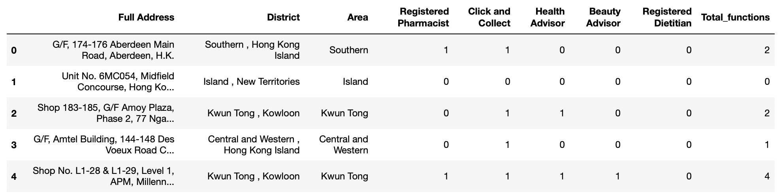
Mannings Data
18 Districts
Store address, district, and its additional store services
1 = Service provided
0 = Not provided

Slide 16
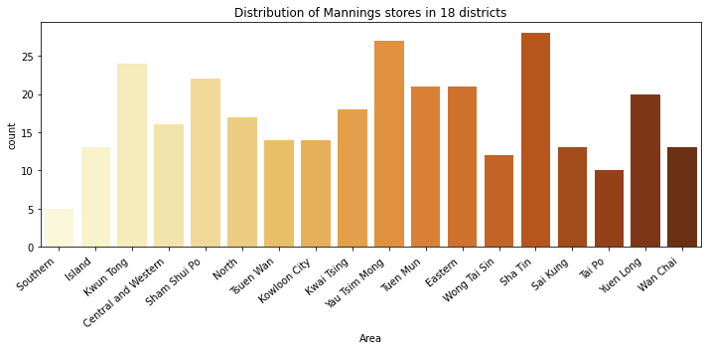
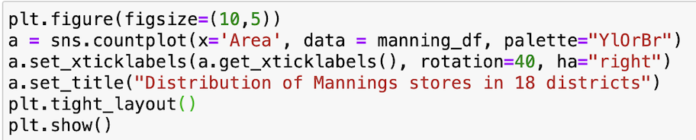
Distribution of Mannings stores
18 Districts
The Most
Sha Tin
Yau Tsim Mong
Kwun Tong
.
.
.
.
Southern
The Least

Slide 17
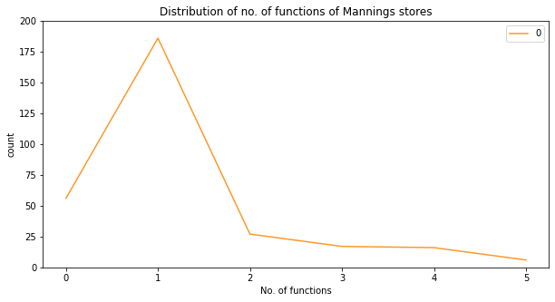
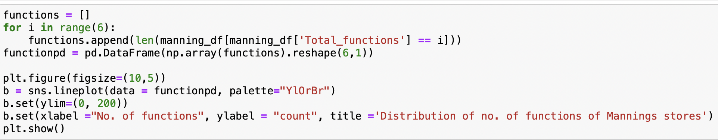
Service of Mannings stores
18 Districts
Only 6 stores have ALL the functions
1.94%
16 stores have FOUR functions
17 stores have THREE functions
27 stores have TWO functions
186 stores have ONE function
56 stores have ZERO function

Slide 18
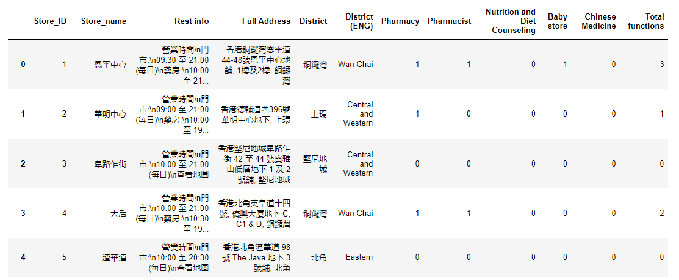
Watsons Data
18 Districts
Store address, district, and its additional store services
1 = Service provided
0 = Not provided

Slide 19
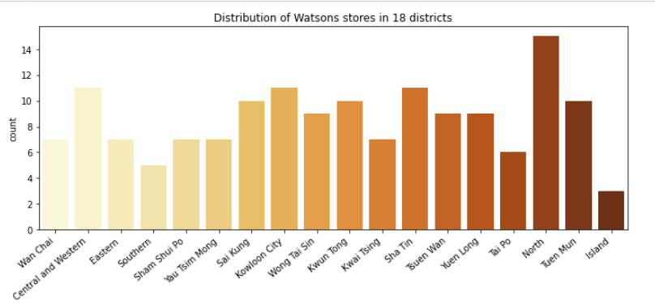
Distribution of Watsons stores
18 Districts
The Most
North
Central and Western
Shatin
Kowloon City
.
.
.
Island
The Least

Slide 20
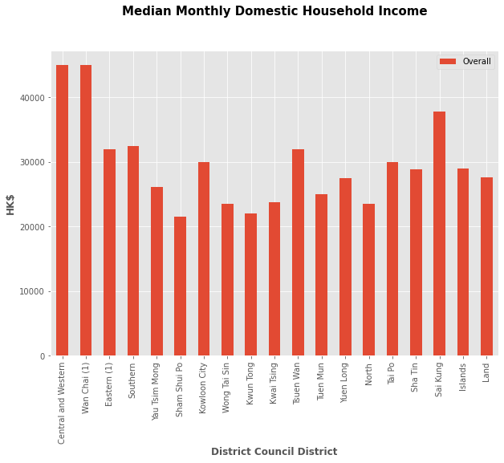
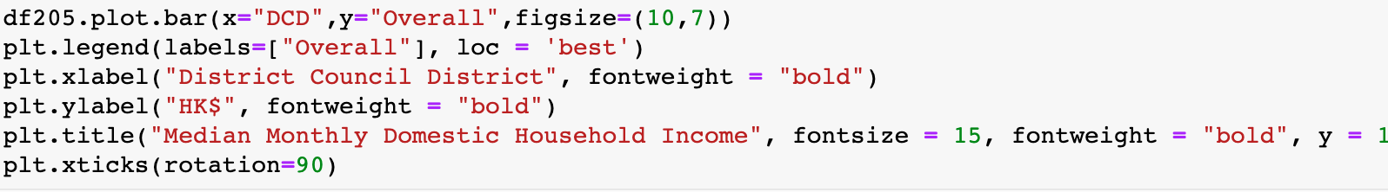
DATA PROCESSING & ANALYSIS
Median Monthly Domestic Household Income(HONG KONG 2021)
Table:E205
The Highest
Central and Western $45040
Wan Chai (1) $45000
Sai Kung $37840
The Lowest
Sham Shui Po $21490
Kwun Tong $22000
Wong Tai Sin $23520
Bar chart ( Matplotlib )

Slide 21
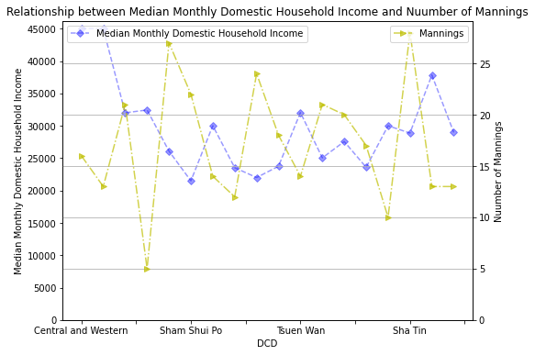
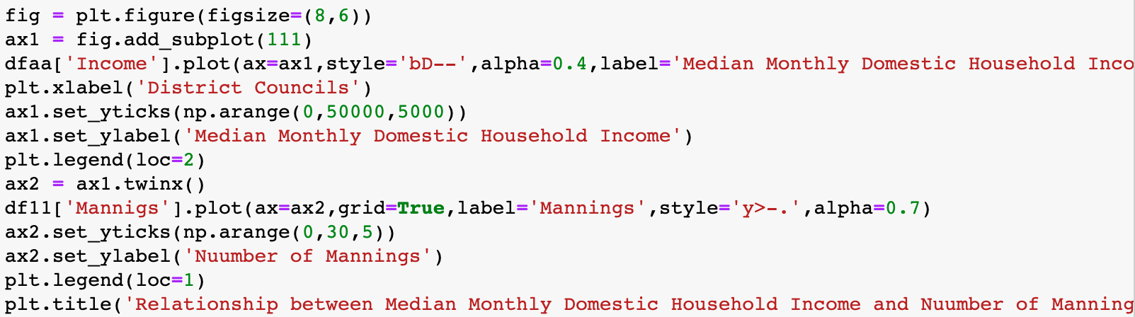
DATA PROCESSING & ANALYSIS
Median Monthly Domestic Household Income(HONG KONG 2021)
Line chart
( Matplotlib )
We cannot find any relationship between Median Monthly Domestic Household Income and Number of Shop

Slide 22
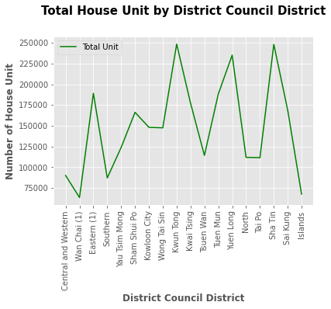
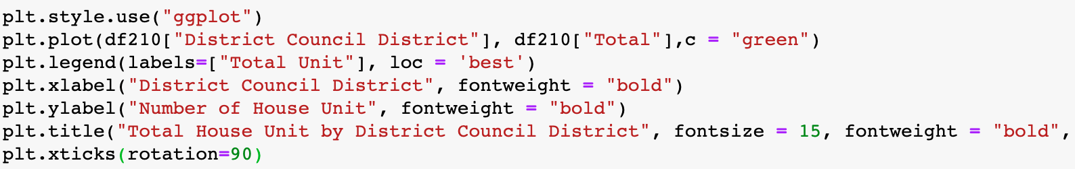
DATA PROCESSING & ANALYSIS
Total House Unit by District Council District (HONG KONG 2021)
Table:E210
The Most
Kwun Tong 248,701 Units
Sha Tin 248,315 Units
Yuen Long 235,362 Units
The Least
Wan Chai (1) 63,455 Units
Islands 67,547 Units
Southern 87,086 Units
Line chart ( Matplotlib )

Slide 23
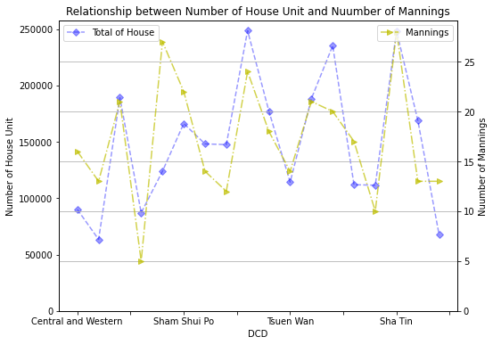
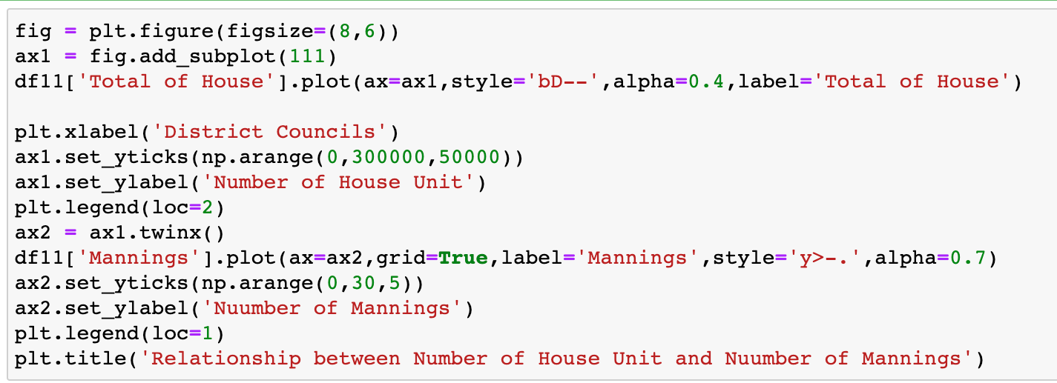
DATA PROCESSING & ANALYSIS
Total House Unit by District Council District (HONG KONG 2021)
Line chart
( Matplotlib )
The relationship between Number of House Unit and Number of Mannings is proportional

Slide 24
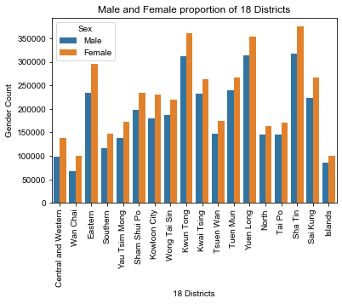
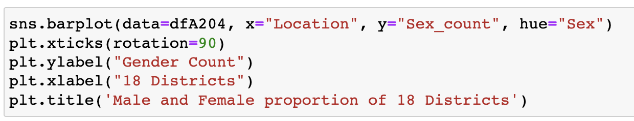
DATA PROCESSING & ANALYSIS
Table.A204
Warehouse management
Female > Male
Stock keep more female related products
Location: Eastern , Kowloon City , Kwun Tong, Sha Tin
Demand Measurement
Spread of population
Location: Sha Tin , Yuen Long, Kwun Tong, Sha Tin
Bar chart ( Seaborn )

Slide 25
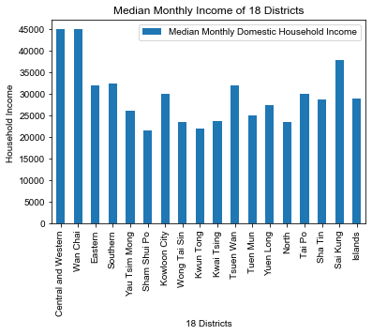
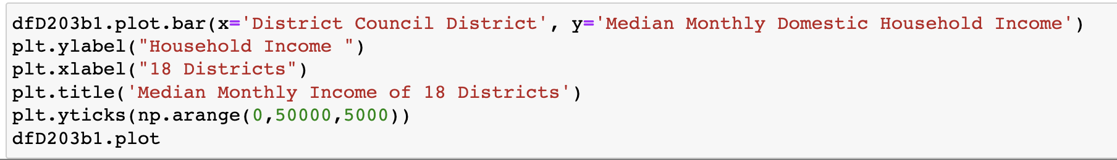
DATA PROCESSING & ANALYSIS
Table.D203b
Consumption power
Product Tier
High-end
Normal Class
Bar chart ( Pandas )

Slide 26
Conclusion
We can see the following by the data
No relationship between Income and Number of Shop
More Number of House Unit ,more Number of Shop
Show Case clients
Suggestion
We suggest more branches can be built in new towns of Hong Kong with more population .

Slide 27
THANKS

